Slide 1
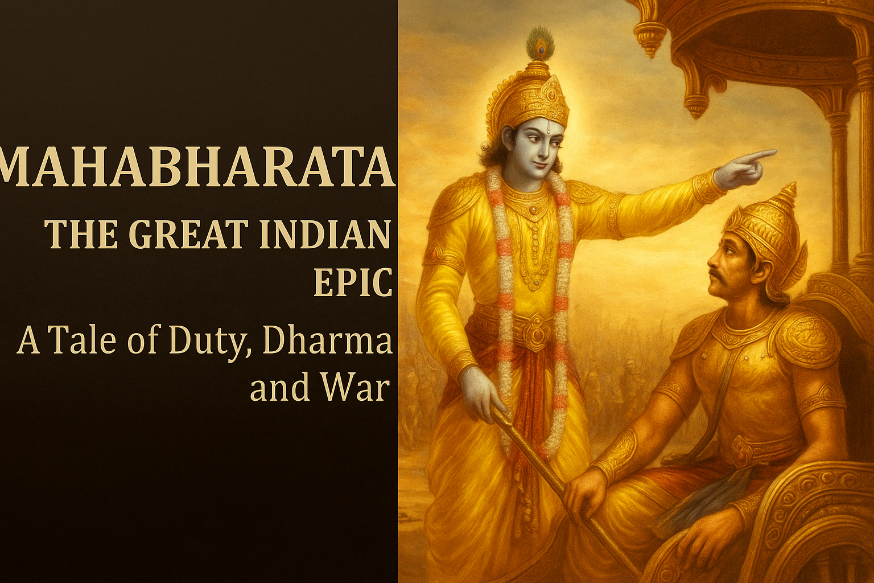
Mahabharata – The Great Indian Epic
Presentation By Rutvi

Slide 2

- Story of the war between the Pandavas and the Kauravas
- Teaches life lessons, morality, and duty

Slide 3
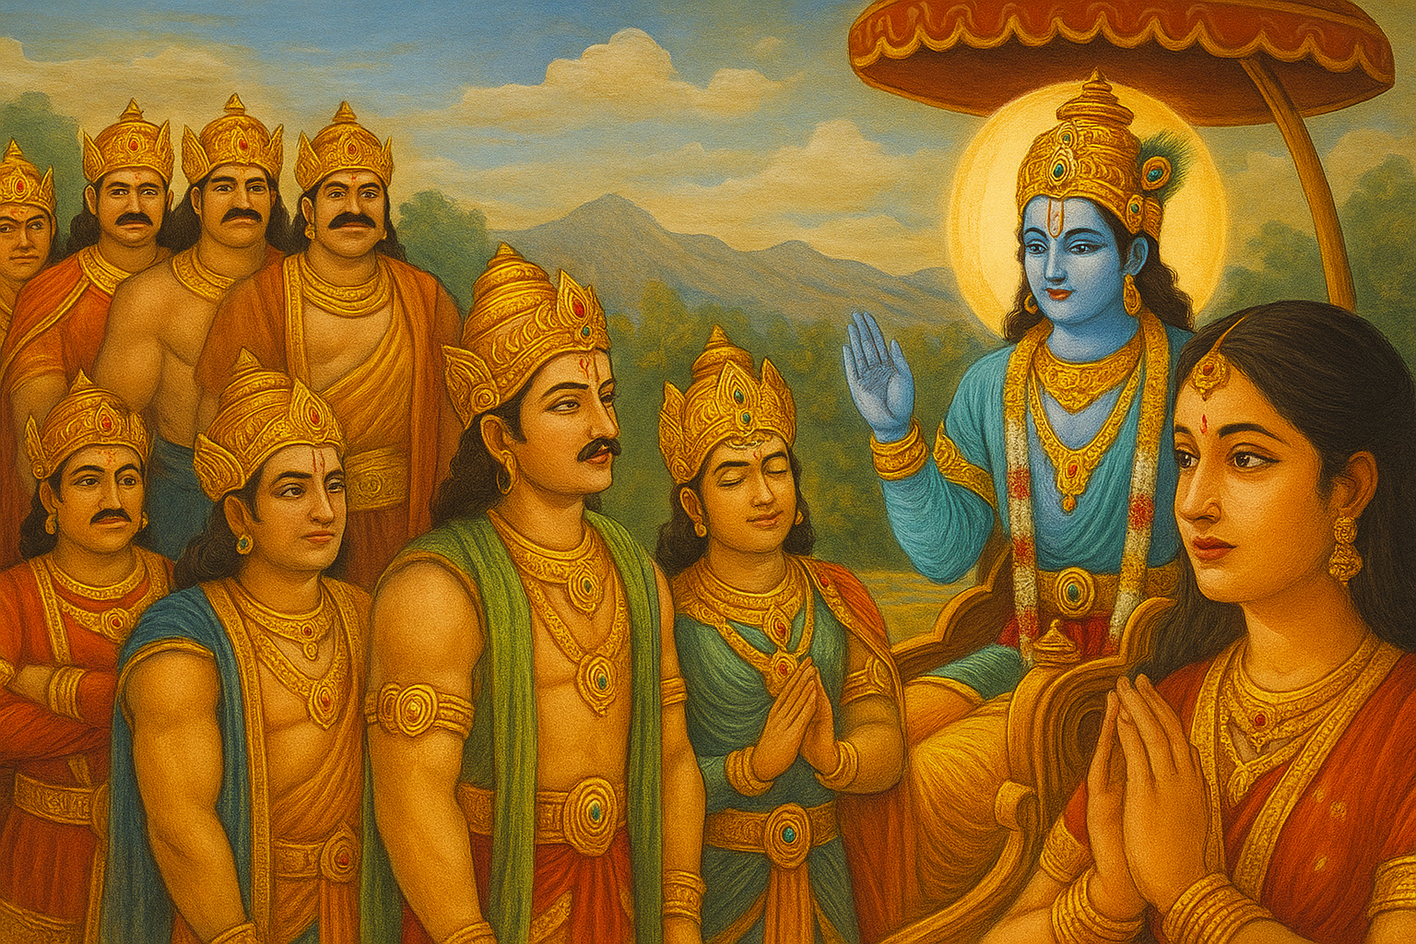
Main Characters
- Pandavas: Yudhishthira, Bhima, Arjuna, Nakula, Sahadeva
- Kauravas: Duryodhana and his 99 brothers
- Lord Krishna: Guide and charioteer to Arjuna
- Draupadi: Wife of the Pandavas, central figure in the conflict

Slide 4
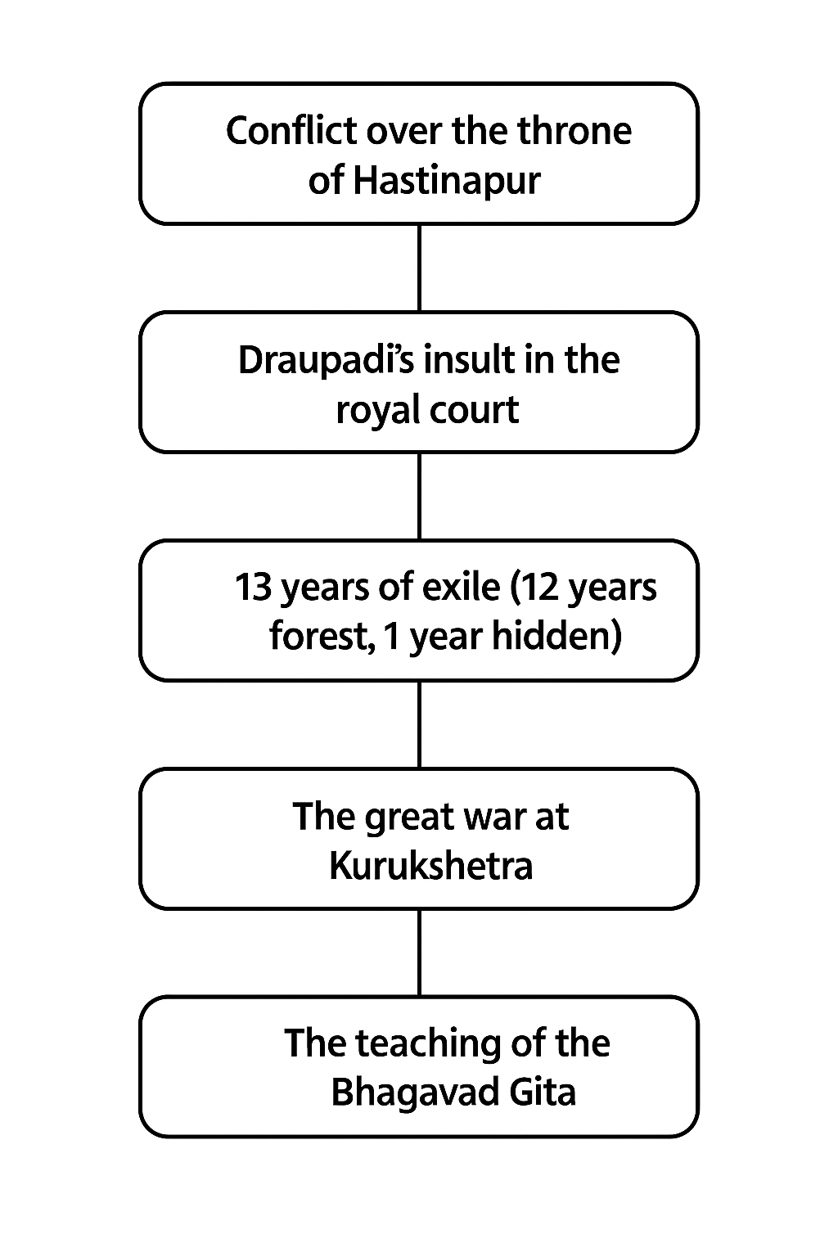
Key Events

Slide 5
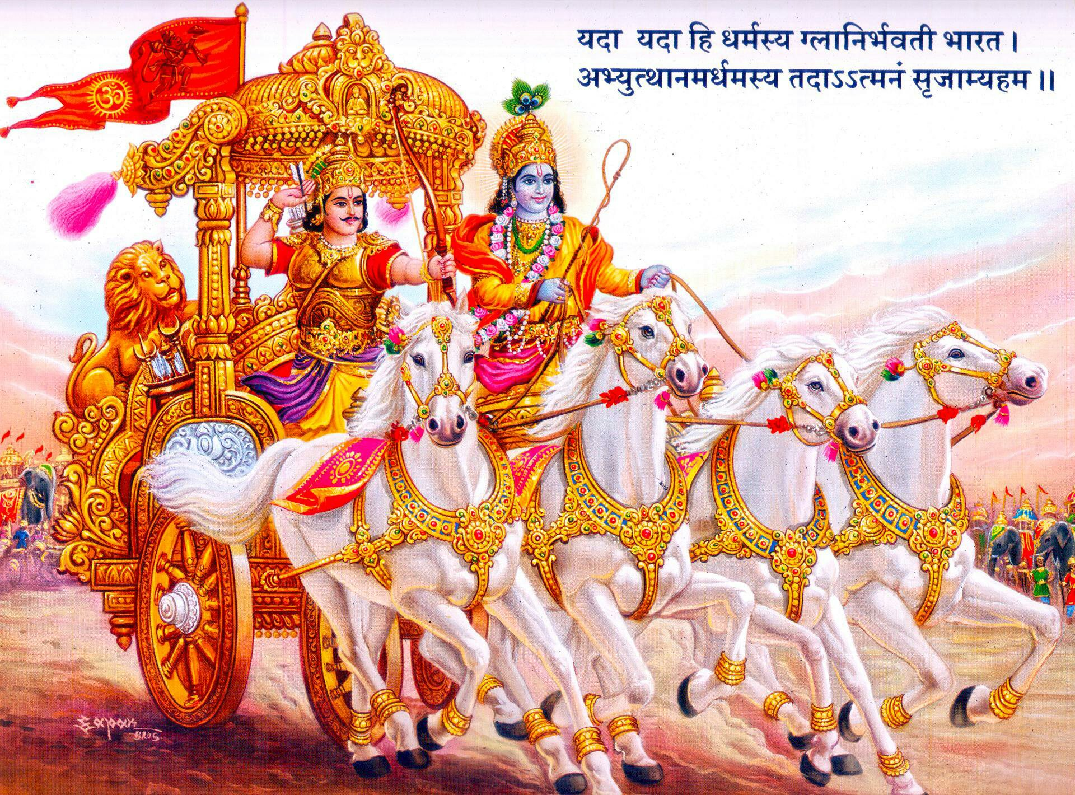
The Kurukshetra War
- Fought for 18 days
- Lord Krishna guided Arjuna
- Warriors: Bhishma, Drona,
Karna, Abhimanyu
- Pandavas emerged
victorious

Slide 6
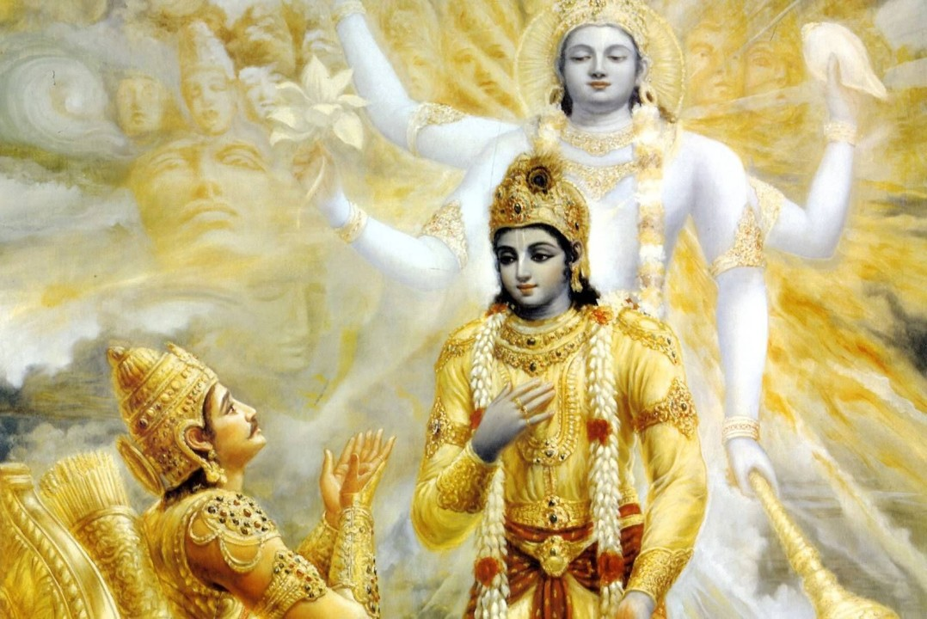
The Bhagavad Gita
- Krishna’s teachings to Arjuna before the war
- Philosophy of karma, duty, and righteousness
- 'Do your duty without attachment to the result' – Key message
- Considered a sacred scripture in Hinduism

Slide 7
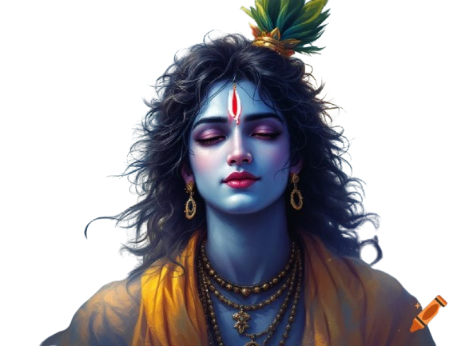
Lessons from Mahabharata
- Truth and righteousness always win
- Ego, greed, and injustice lead to destruction
- Stand by your duty even in tough times
- Wisdom and patience are key in life

Slide 8
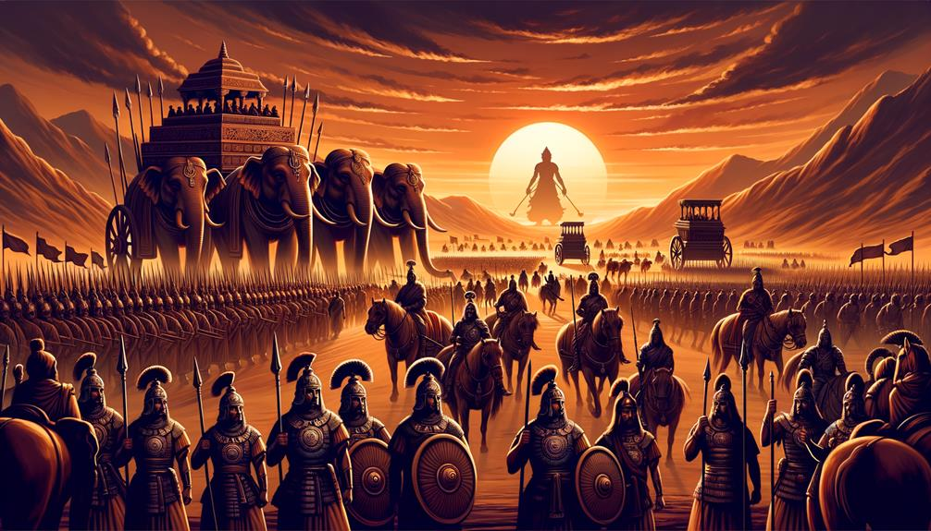
Conclusion
- Mahabharata is not just a story – it’s a guide to life
- Shows the complexity of human nature
- The message of Gita is relevant even today
- Teaches us how to live a life of values

Slide 9

Thank You!
“Dharma will always triumph.”
Thank you for watching! 🙏

